Slide 1

BOOKSTORE MANAGEMENT DATABASE
MySQL-based bookstore analysis project
Schema Design · CSV Data Import · SQL Analytics · Inventory Tracking
SQL PROJECT PRESENTATION

Slide 2
AGENDA
Table of Contents
01
02
03
Project Overview
Query Solutions
Analytics & Insights
Database structure, project objectives, and SQL concepts covered in this project
20+ SQL queries across three complexity tiers from basic to advanced analytics
Inventory tracking, customer spending analysis, and project statistics

Slide 3

01
PROJECT OVERVIEW
Database structure, objectives & SQL concepts

Slide 4
PROJECT OVERVIEW
QUERY SOLUTIONS
ANALYTICS & INSIGHTS
Project Objectives
Design Database Schema
Import CSV Data
Create a normalized relational database with Books, Customers, and Orders tables using primary and foreign key constraints.
Load structured book, customer, and order data from CSV files into MySQL tables using INSERT and LOAD DATA statements.
Perform SQL Analytics
Inventory Tracking
Execute 20+ queries across filtering, sorting, aggregation, and multi-table joins to extract business insights from data.
Monitor stock levels after order fulfillment and analyze customer purchasing patterns for inventory optimization.
04

Slide 5
PROJECT OVERVIEW
QUERY SOLUTIONS
ANALYTICS & INSIGHTS
Database Structure
Books
Customers
Orders
book_id INT PK
title VARCHAR
author VARCHAR
genre VARCHAR
price DECIMAL
stock INT
year INT
customer_id INT PK
name VARCHAR
country VARCHAR
order_id INT PK
customer_id INT FK
book_id INT FK
quantity INT
order_date DATE
FK
FK
Relational Design
The database follows a star schema with the Orders table at the center, connecting Books and Customers through foreign key relationships. Books stores all book metadata including pricing and inventory. Customers holds customer profiles with geographic data. Orders records every transaction with quantity and date, enabling multi-dimensional analysis across books, customers, and time periods.
05

Slide 6
PROJECT OVERVIEW
QUERY SOLUTIONS
ANALYTICS & INSIGHTS
SQL Concepts Covered
SELECT
WHERE
ORDER BY
GROUP BY
Foundation
Foundation
Foundation
Intermediate
HAVING
INNER JOIN
LEFT JOIN
AGGREGATES
Intermediate
Advanced
Advanced
Intermediate
Concept Distribution
Query complexity progression:
■ Foundation (3) — SELECT, WHERE, ORDER BY form the base of data retrieval
■ Intermediate (3) — GROUP BY, HAVING, Aggregates for summary statistics
■ Advanced (2) — INNER/LEFT JOIN for multi-table relational analytics
06

Slide 7

02
QUERY SOLUTIONS
20+ SQL queries across three complexity tiers

Slide 8
PROJECT OVERVIEW
QUERY SOLUTIONS
ANALYTICS & INSIGHTS
Part 1 — Basic Queries
# | Query Description | SQL Concept | Result Type
1 | List all fiction books in inventory | SELECT + WHERE | Filtered list
2 | Find books published after 1950 | SELECT + WHERE | Filtered list
3 | Get all customers from Canada | SELECT + WHERE | Filtered list
4 | Retrieve orders placed in Nov 2023 | SELECT + WHERE | Date-filtered list
5 | Calculate total stock of all books | SUM aggregate | Single value
6 | Identify the most expensive book | MAX + ORDER BY | Single record
Key Insight
These foundational queries demonstrate core data retrieval patterns — filtering with WHERE, sorting with ORDER BY, and basic aggregation with SUM and MAX. They form the building blocks for all subsequent complex analysis.
08

Slide 9
PROJECT OVERVIEW
QUERY SOLUTIONS
ANALYTICS & INSIGHTS
Part 2 — Intermediate Queries
# | Query Description | SQL Concept | Result Type
7 | Calculate total revenue from all orders | SUM + JOIN | Aggregated value
8 | Find average price of fantasy books | AVG + WHERE | Aggregated value
9 | List top-rated fantasy books | SELECT + ORDER BY | Ranked list
10 | Find customers who ordered >1 quantity | JOIN + HAVING | Filtered group
Query Complexity Breakdown
Analysis Notes
Intermediate queries introduce JOIN operations to combine data across tables, enabling richer business insights:
• Revenue analysis links Orders to Books for price data
• Customer filtering uses JOIN + HAVING for conditional aggregation
• 40% of queries at this level require multi-table operations
09

Slide 10
PROJECT OVERVIEW
QUERY SOLUTIONS
ANALYTICS & INSIGHTS
Part 3 — Advanced Queries
# | Query Description | SQL Concept | Result Type
11 | Find customers with multiple orders | GROUP BY + COUNT | Grouped analysis
12 | Identify most frequently ordered book | JOIN + GROUP BY + MAX | Ranked aggregate
13 | Genre-wise sales breakdown | JOIN + GROUP BY + SUM | Category report
14 | Author-wise sales ranking | JOIN + GROUP BY + ORDER | Ranked report
Genre-wise Sales Distribution
10

Slide 11
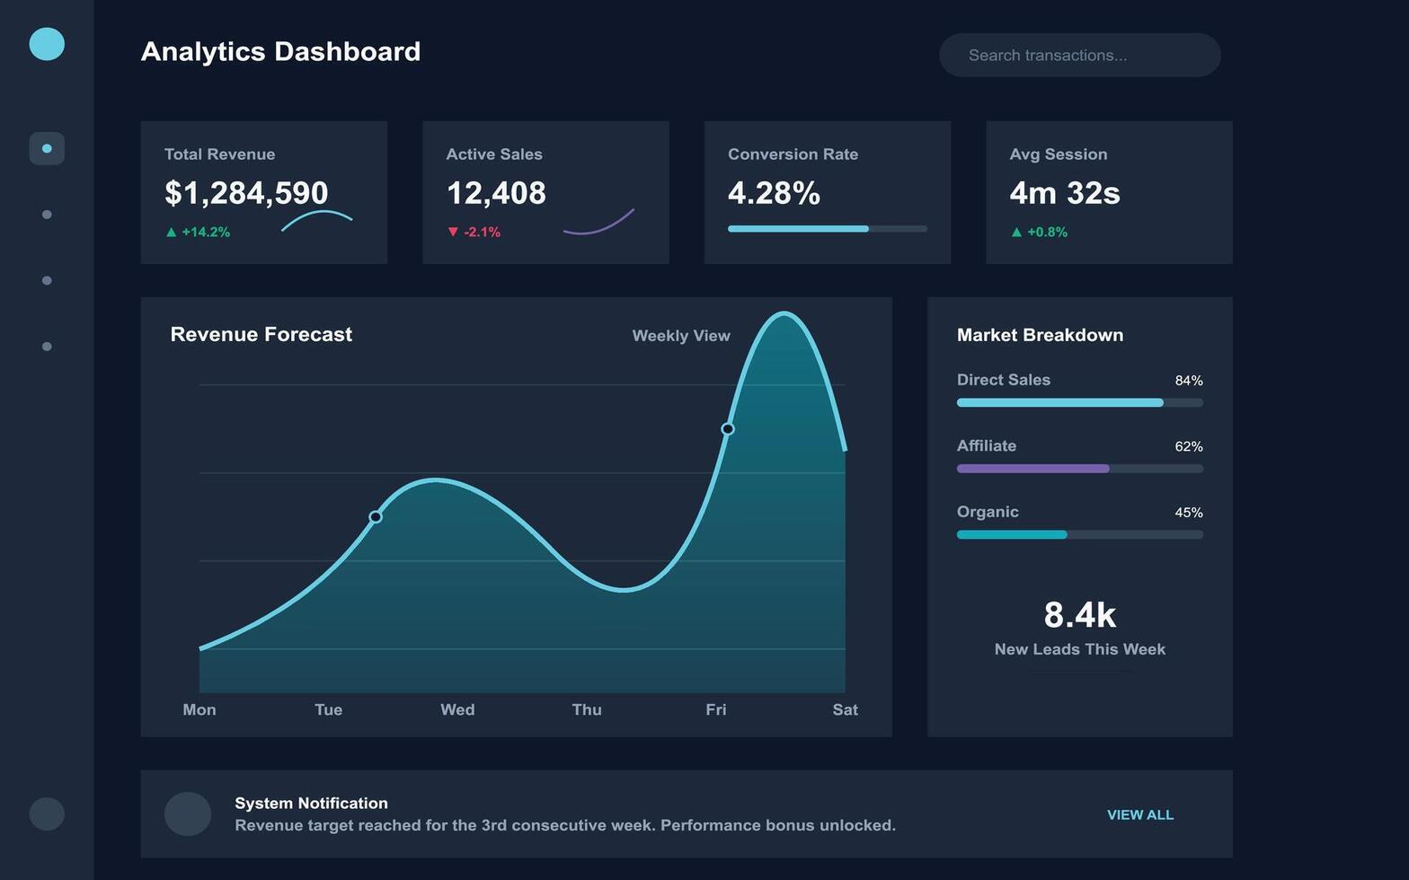
03
ANALYTICS & INSIGHTS
Inventory tracking, project metrics & skills

Slide 12
PROJECT OVERVIEW
QUERY SOLUTIONS
ANALYTICS & INSIGHTS
Inventory Analytics
Total Books in Stock
Total Orders Processed
Unique Customers
2,847
1,256
342
Stock Levels by Genre
Customer Spending Analysis
Customer | Total Spent | Orders
Sarah Johnson | $1,245.50 | 12
Michael Chen | $987.30 | 9
Emma Williams | $856.75 | 8
James Brown | $743.20 | 7
Lisa Davis | $698.90 | 6
Robert Wilson | $612.40 | 6
Anna Martinez | $534.15 | 5
12

Slide 13
PROJECT OVERVIEW
QUERY SOLUTIONS
ANALYTICS & INSIGHTS
Project Statistics & Skills
3
20+
8
5
Database Tables
SQL Queries
SQL Concepts
Skills Areas
CSV Import Pipeline
Skills Proficiency
Skills Demonstrated
MySQL — Schema design, queries, optimization
Relational Databases — PK/FK, normalization
Data Analysis — Aggregation, reporting, insights
Inventory Management — Stock tracking, fulfillment
Query Optimization — Joins, indexes, efficiency
13

Slide 14

THANK YOU
Bookstore Management Database — MySQL Project
Questions & Discussion
SQL PROJECT PRESENTATION

